Slide 1
광양 242BRC 2D 충돌방지
Config 정리
20180809

Slide 2
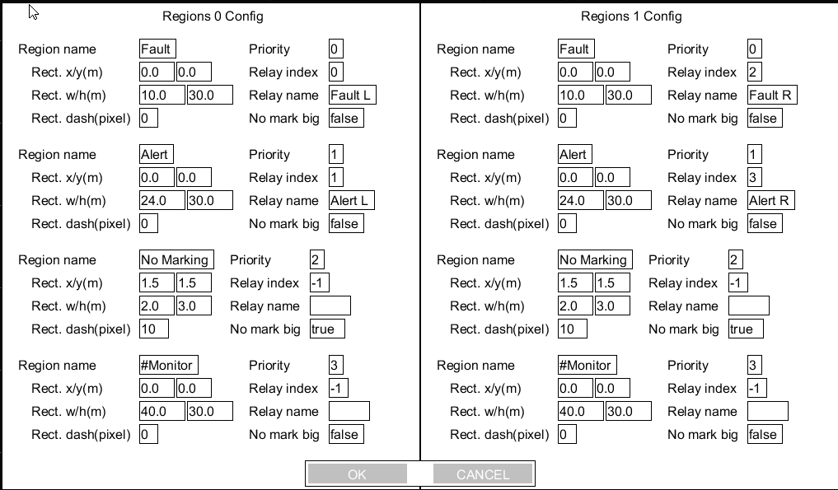
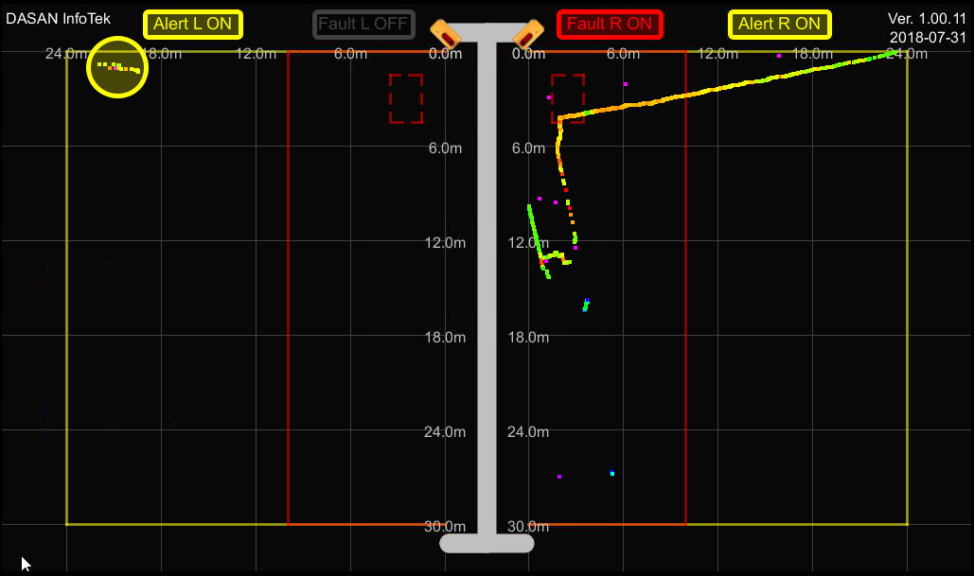
Default Setting

Slide 3
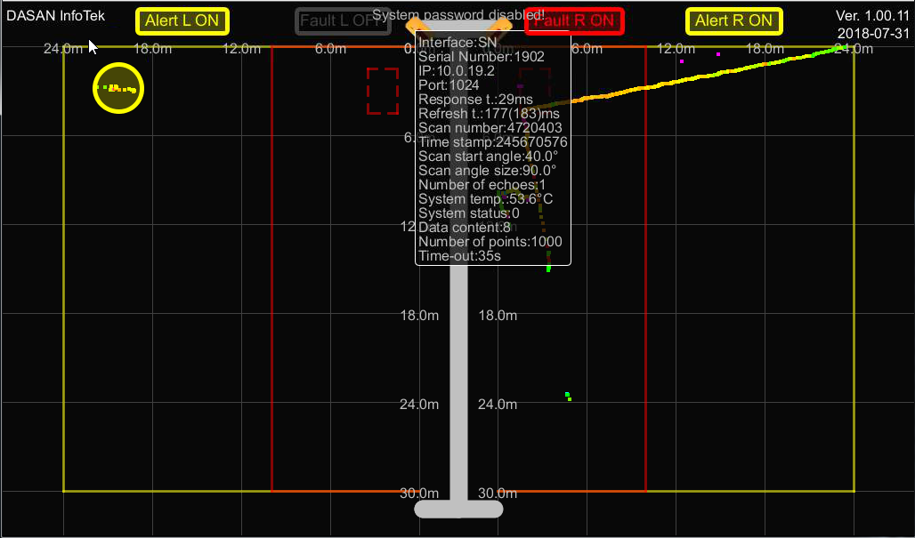
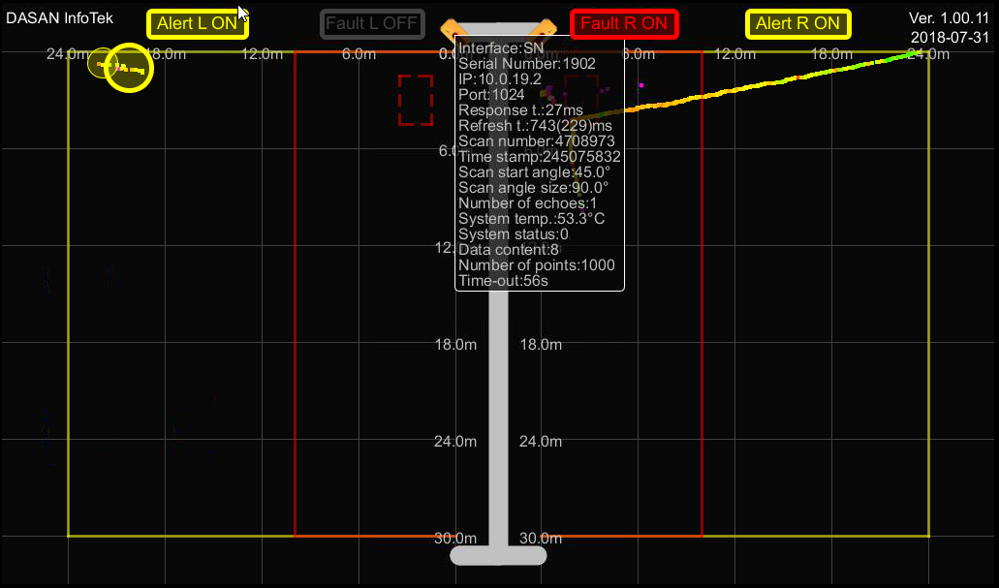
Scan Start Angle 40’
Scan angle Size 90’
Scan Start Angle 45’
Scan angle Size 90’

Slide 4
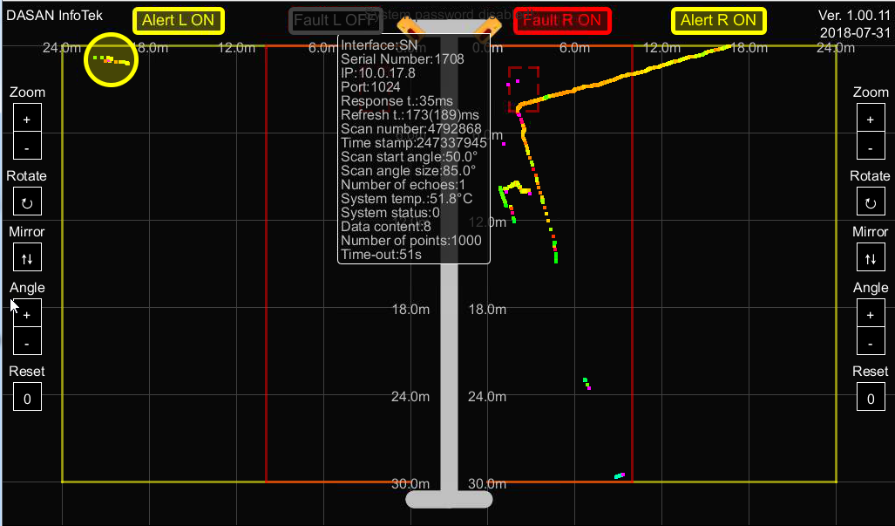
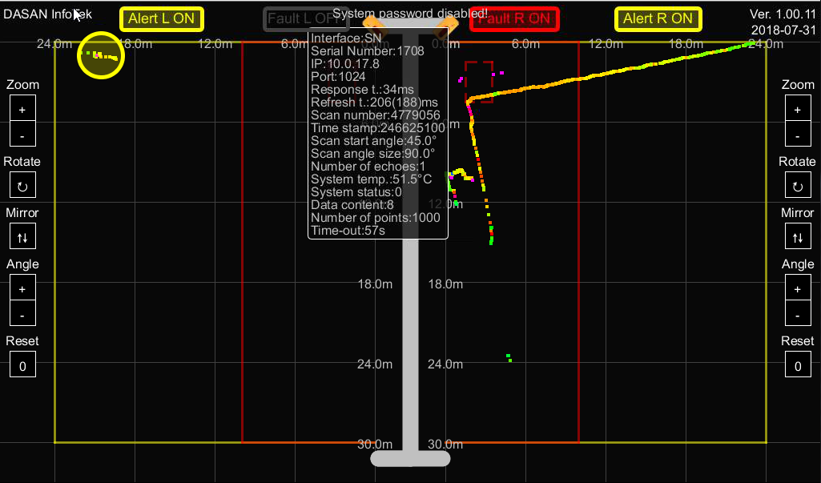
Scan Start Angle 50’
Scan angle Size 85’
Default Setting
Scan Start Angle 45’
Scan angle Size 90’

Slide 5

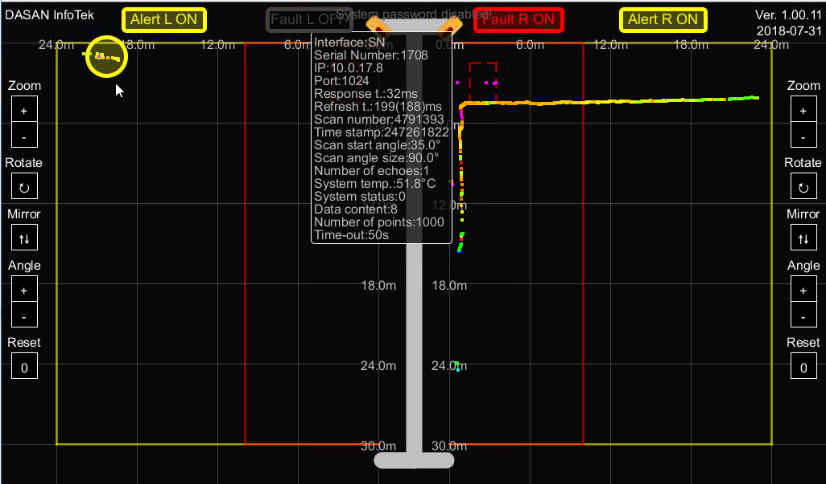
Scan Start Angle 42’
Scan angle Size 90’
Default Setting
Scan Start Angle 35’
Scan angle Size 90’

Slide 6
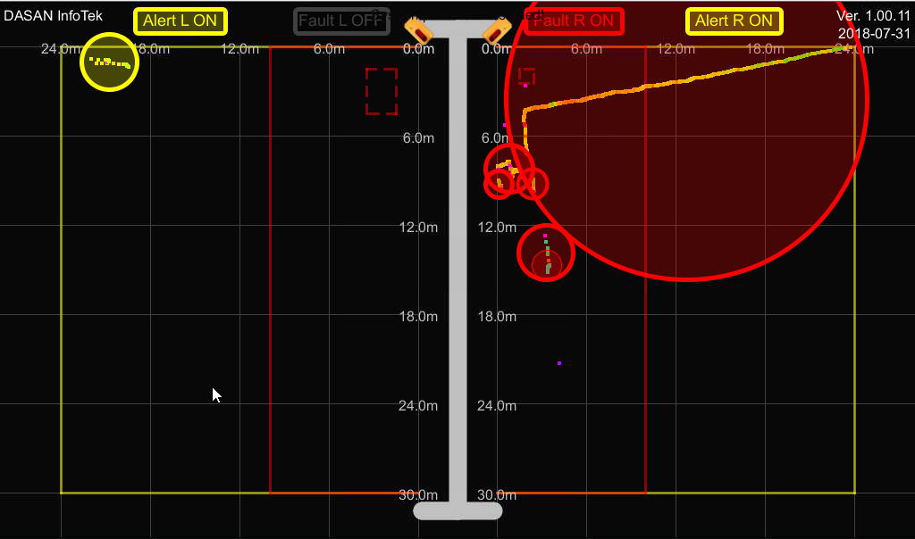
No Marking 1.0 / 1.0 적용
NO Marking Flase
1.0
1.0
NO Marking True

